Slide 1



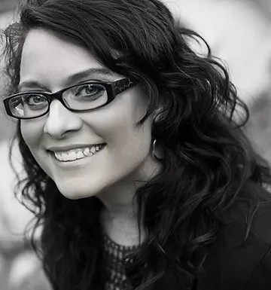
Shelli R. Johannes – Author Visits & Workshops
About me
I am the author of 25+ books for children and teens. This includes the Cece Loves Science series, Penny (An Engineering Tale of the Fourth Pig), and the Farm Friends series. My STEM books were a B&N National selection, an Amazon Best Book of the Month, the NSTA Picture Book of the Year, and received starred reviews from SLJ. I am also the author of the Theo Thesaurus series, Shine Like a Unicorn, and Florence Nightingale (in Chelsea Clinton's "She Persisted" series.) For teens, I have five novels, including the Nature of Grace series (Untraceable, Uncontrollable, Unstoppable), ReWired, & On the Bright Side (MG), which have been praised by Publishers Weekly, Kirkus Reviews, and Suspense Magazine.
📚 Programs for Students (All Grades, PreK - 12)
Loves Science & Reading (K–3 | 30 minutes)
Interactive read-aloud from any Loves Science book, followed by a fun discussion on what students learned.
Loves Science, Reading & Writing (K–3 | 45 minutes)
Read-aloud of Cece Loves Science plus a discussion on the three essential elements every book needs.
Theo TheSaurus – Fall in Love with Words (K–3 | 45 minutes)
A lively reading of Theo TheSaurus with a playful discussion on how to fall in love with reading and writing.
Shine Like a Unicorn - Stand out in a Crowd (Pre k-2 | 45 minutes)
Perfect for anti-bullying week! Reading + discussion about standing out, embracing differences, and being yourself.
Penny – Writing Humor and Simple Machines (2-5 | 45 minutes)
Explores engineering and simple machines while teaching students how to write with humor, puns, and creativity.
Keeping It Real with Research (Florence Nightingale) (Grades 4-8)
Hands-on writing program exploring how to research for fiction and nonfiction. Uses Florence Nightingale as an example.
The Writer in You (Grades 5–12 | 60 minutes)
A writing workshop walking students through the nuts and bolts of storytelling.
Turn That Page (Grades 7–12 | 60 minutes)
Focused on building suspense, raising the stakes, and writing stories readers can’t put down.
💵 Pricing for In-Person Visits
Half Day: $900 = 2 sessions + lunch + signing
Full Day: $1,300 = 4 sessions + lunch + signing + bookmarks
Customized Options Available!
srjohannes. com

Slide 2










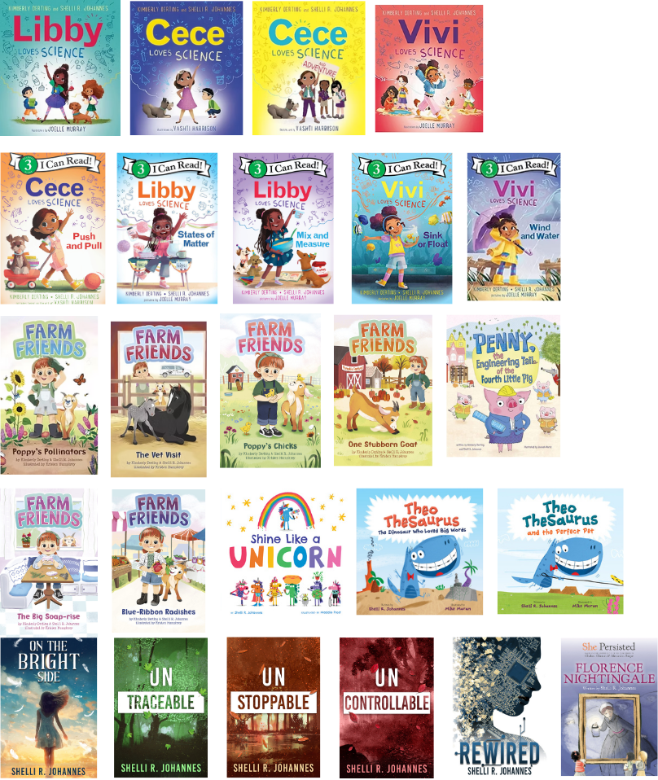
Half-day visits are only available within 25 miles or when two schools share a full day. Donation options are available. Additional fees may apply for longer trips (over 100 miles).
Full day sessions are customized to fit your curriculum. There is no limit on the number of students or the number of books used for grades.
Group Discounts:
Discounts available for multiple schools booking together or multiple days.
✨ What’s Included with Every School Visit
Bookmarks for each student
Meet & greet with select students/teachers
Book signing session
Educator Guides and Activities aligned to Common Core
📖 Book Sales
Signed book pre-orders and school-wide book sales can be arranged. I can work with a local bookstore or create an online sale through AuthorVisitCentral.com so there’s no need to collect money or forms, and it
supports local indie bookstores! I will provide a link and a flyer to make it easy.
💻 Virtual Visits
Free Skype Visits (15 minutes)
Includes a book read-aloud and short Q&A.
A budget-friendly option for schools anywhere in the world!
Works for classrooms or libraries of any size.
Kids must have read at least one of my books.
👩‍🏫 Educator Professional Development
Workshops designed to give educators creative ways to use books across multiple subjects and media, including science, social studies, and literature.
🔗 Booking Information
Sample Workshops:
Using Fiction to Emphasize Science, STEM, and Other Topics
Teaching with Multi-Genre/Multi-Modal Writing
Researching "real stories" for Non-Fiction Projects
Email:
shelli@srjohannes.com
to book your school visit today.
Website: srjohannes.com
srjohannes. com

